Slide 1
Task 7
KH5003

Slide 2



Marketing on Social Networks
You work as an algorithm developer for a company in the R&D department.
The social media marketing team has observed that
Targeting random users on Instagram & Twitter is not effective.
It’s more effective to market to the biggest groups of accounts where every pair of users either:
Follow each other, or
there is a chain of mutual followers between them.
People in this type of social structure tend of have similar interests.
It’s more likely they’re interested in the same products.
Your task: Develop an algorithm that identifies such groups.
Group 4
Group 1
Group 2
Group 3

Slide 3
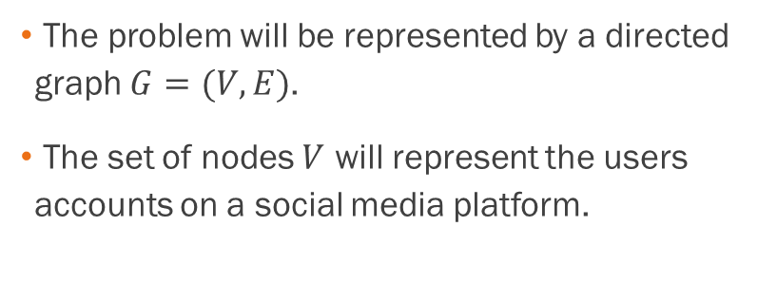
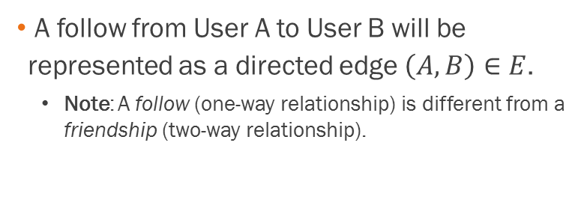
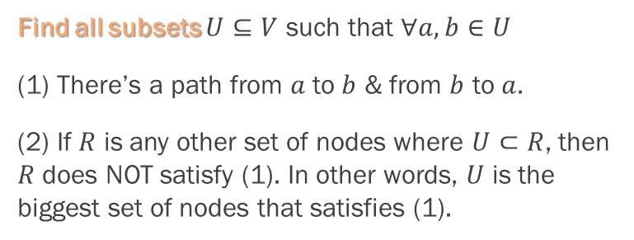

Problem Representation
Find the biggest groups of accounts where every pair of users either:
Follow each other, or
there is a chain of mutual followers between them.

Slide 4
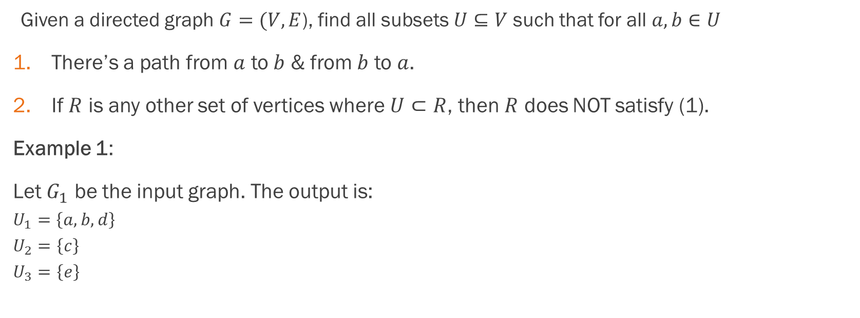

Problem Definition
a
b
c
d
e

Slide 5
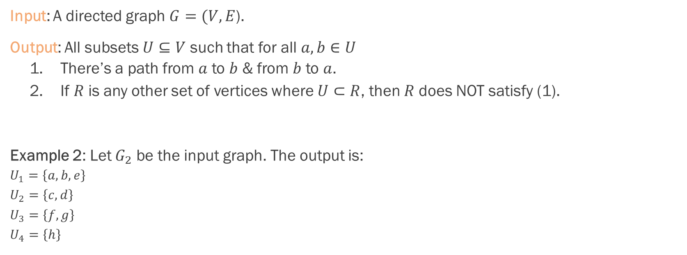

Problem Definition
a
b
c
d
e
f
g
h

Slide 6
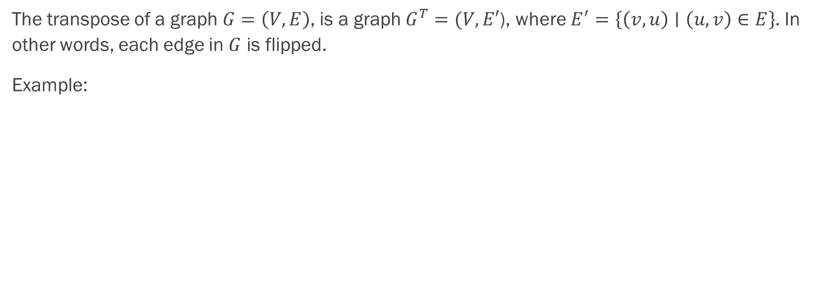
Transpose of a Graph
a
b
c
d
a
b
c
d
Transpose
e
f
g
h
e
f
g
h

Slide 7
The Algorithm
Run DFS on the graph & keep track of which node finished first.
Compute the transpose of the graph.
Run DFS on the transpose of the graph starting by the nodes that finished last in the 1st DFS run.
The largest groups of users are the set of nodes reachable from every vertex on which DFS ran in Step (3).

Slide 8
Step-by-Step Example 2/
a
c
e
h
i
b
d
f
g
j
k
Visited | b
Finished

Slide 9
Step-by-Step Example 3/
a
c
e
h
i
b
d
f
g
j
k
Visited | b | c
Finished

Slide 10
Step-by-Step Example 4/
a
c
e
h
i
b
d
f
g
j
k
Visited | b | c | a
Finished

Slide 11
Step-by-Step Example 5/
a
c
e
h
i
b
d
f
g
j
k
b has already been visited & thus all children of a have been visited. So a is finished.
Visited | b | c | a
Finished | a

Slide 12
Step-by-Step Example 6/
Go back to c
a
c
e
h
i
b
d
f
g
j
k
b has already been visited & thus all children of a have been visited. So a is finished.
Visited | b | c | a
Finished | a

Slide 13
Step-by-Step Example 7/
a
c
e
h
i
b
d
f
g
j
k
c has no more children, so it’s finished.
Go back to b.
Visited | b | c | a
Finished | a | c

Slide 14
Step-by-Step Example 7/
a
c
e
h
i
b
d
f
g
j
k
Visited | b | c | a | d
Finished | a | c

Slide 15
Step-by-Step Example 8/
a
c
e
h
i
b
d
f
g
j
k
Visited | b | c | a | d | e
Finished | a | c

Slide 16
Step-by-Step Example 9/
a
c
e
h
i
b
d
f
g
j
k
Visited | b | c | a | d | e | f
Finished | a | c

Slide 17
Step-by-Step Example 10/
a
c
e
h
i
b
d
f
g
j
k
d has already been visited.
Go back to f, which has no more children to visit, which means f is finished.
Visited | b | c | a | d | e | f
Finished | a | c | f

Slide 18
Step-by-Step Example 11/
a
c
e
h
i
b
d
f
g
j
k
Go back to e, which has no more children to visit, which means e is finished.
Visited | b | c | a | d | e | f
Finished | a | c | f | e

Slide 19
Step-by-Step Example 12/
a
c
e
h
i
b
d
f
g
j
k
Go back to d, which has no more children, which means d is finished.
Visited | b | c | a | d | e | f
Finished | a | c | f | e | d

Slide 20
Step-by-Step Example 13/
a
c
e
h
i
b
d
f
g
j
k
Go back to b, which has no more children, which means b is finished.
Visited | b | c | a | d | e | f
Finished | a | c | f | e | d | b

Slide 21
Step-by-Step Example 14/
Pick any node which has NOT been visited, let’s say i.
a
c
e
h
i
b
d
f
g
j
k
Visited | b | c | a | d | e | f | i
Finished | a | c | f | e | d | b

Slide 22
Step-by-Step Example 15/
a
c
e
h
i
b
d
f
g
j
k
Visited | b | c | a | d | e | f | i | j
Finished | a | c | f | e | d | b

Slide 23
Step-by-Step Example 16/
a
c
e
h
i
b
d
f
g
j
k
Visited | b | c | a | d | e | f | i | j | k
Finished | a | c | f | e | d | b

Slide 24
Step-by-Step Example 17/
a
c
e
h
i
k has no more children, so it’s finished.
Go back to j.
b
d
f
g
j
k
Visited | b | c | a | d | e | f | i | j | k
Finished | a | c | f | e | d | b | k

Slide 25
Step-by-Step Example 18/
a
c
e
h
i
b
d
f
g
j
k
f has already been visited.
Visited | b | c | a | d | e | f | i | j | k | g
Finished | a | c | f | e | d | b | k

Slide 26
Step-by-Step Example 19/
a
c
e
h
i
b
d
f
g
j
k
Visited | b | c | a | d | e | f | i | j | k | g | h
Finished | a | c | f | e | d | b | k

Slide 27
Step-by-Step Example 20/
h has no more children, so h is finished.
Go back to g.
a
c
e
h
i
b
d
f
g
j
k
Visited | b | c | a | d | e | f | i | j | k | g | h
Finished | a | c | f | e | d | b | k | h

Slide 28
Step-by-Step Example 21/
a
c
e
h
i
b
d
f
g
j
k
g has no more children, so g is finished.
Go back to j.
Visited | b | c | a | d | e | f | i | j | k | g | h
Finished | a | c | f | e | d | b | k | h | g

Slide 29
Step-by-Step Example 21/
a
c
e
h
i
b
d
f
g
j
k
j has no more children, so it’s finished.
Go back to i.
Visited | b | c | a | d | e | f | i | j | k | g | h
Finished | a | c | f | e | d | b | k | h | g | j

Slide 30
Step-by-Step Example 22/
a
c
e
h
i
b
d
f
g
j
k
i has no more children, so it’s finished.
Visited | b | c | a | d | e | f | i | j | k | g | h
Finished | a | c | f | e | d | b | k | h | g | j | i

Slide 31
Step-by-Step Example 23/
a
c
e
h
i
b
d
f
g
j
k
Transpose computed.
Run DFS by the reverse
order of finished nodes.
Visited
Finished | a | c | f | e | d | b | k | h | g | j | i

Slide 32

Step-by-Step Example 24/
a
c
e
h
i
b
d
f
g
j
k
Visited | i
Finished | a | c | f | e | d | b | k | h | g | j

Slide 33

Step-by-Step Example 25/
a
c
e
h
i
b
d
f
g
j
k
Visited | i | h
Finished | a | c | f | e | d | b | k | h | g | j

Slide 34

Step-by-Step Example 26/
a
c
e
h
i
b
d
f
g
j
k
Visited | i | h | g
Finished | a | c | f | e | d | b | k | h | g | j

Slide 35

Step-by-Step Example 27/
a
c
e
h
i
b
d
f
g
j
k
Visited | i | h | g | j
Finished | a | c | f | e | d | b | k | h | g | j

Slide 36
Step-by-Step Example 28/
i has already been visited.
We return to g, which has no unvisited children.
We return to h, which has no unvisited children.
We return to i, which has no unvisited children.
a
c
e
h
i
b
d
f
g
j
k
Visited | i | h | g | j
Finished | a | c | f | e | d | b | k | h | g | j

Slide 37
Step-by-Step Example 29/
a
c
e
h
i
b
d
f
g
j
k
Visited | i | h | g | j
We pop the next vertex, j, but it has already been visited, so we ignore it and pop the next one.
Finished | a | c | f | e | d | b | k | h | g

Slide 38
Step-by-Step Example 30/
a
c
e
h
i
b
d
f
g
j
k
Visited | i | h | g | j
Vertices g & h as well have been visited, so we ignore them and keep looking for a fresh vertex until we get to k.
Finished | a | c | f | e | d | b | k

Slide 39
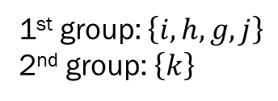
Step-by-Step Example 31/
a
c
e
h
i
k has no unvisited children.
b
d
f
g
j
k
Visited | i | h | g | j | k
Finished | a | c | f | e | d | b

Slide 40
Step-by-Step Example 32/
a
c
e
h
i
b
d
f
g
j
k
Visited | i | h | g | j | k
Pop out b.
Finished | a | c | f | e | d | b

Slide 41
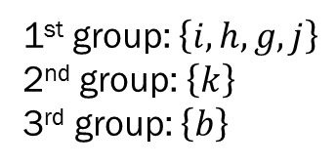
Step-by-Step Example 33/
a
c
e
h
i
b
d
f
g
j
k
Visited | i | h | g | j | k | b
Finished | a | c | f | e | d

Slide 42
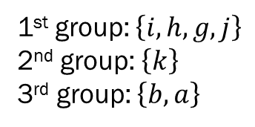
Step-by-Step Example 34/
a
c
e
h
i
b
d
f
g
j
k
Visited | i | h | g | j | k | b | a
Finished | a | c | f | e | d

Slide 43
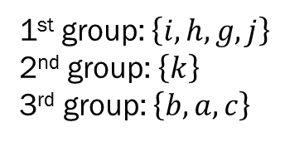
Step-by-Step Example 35/
a
c
e
h
i
b
d
f
g
j
k
Visited | i | h | g | j | k | b | a | c
Finished | a | c | f | e | d

Slide 44
Step-by-Step Example 36/
a
c
e
h
i
b
d
f
g
j
k
Visited | i | h | g | j | k | b | a | c
Finished | a |  | f | e | d

Slide 45
Step-by-Step Example 37/
a
c
e
h
i
b
d
f
g
j
k
Visited | i | h | g | j | k | b | a | c
Finished |  |  | f | e | d

Slide 46
Step-by-Step Example 38/
a
c
e
h
i
b
d
f
g
j
k
Visited | i | h | g | j | k | b | a | c
Pop out d.
Finished |  |  | f | e | d

Slide 47
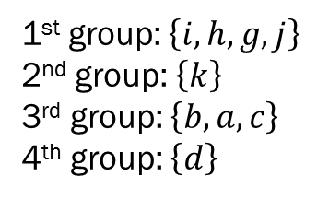
Step-by-Step Example 39/
a
c
e
h
i
b
d
f
g
j
k
Visited | i | h | g | j | k | b | a | c | d
Finished |  |  | f | e

Slide 48
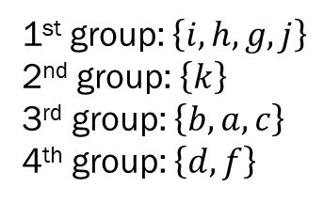
Step-by-Step Example 40/
a
c
e
h
i
b
d
f
g
j
k
Visited | i | h | g | j | k | b | a | c | d | f
Finished |  |  | f | e

Slide 49
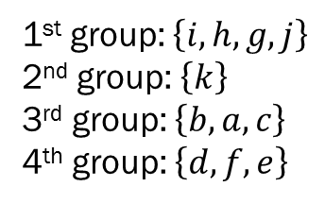
Step-by-Step Example 41/
a
c
e
h
i
b
d
f
g
j
k
Visited | i | h | g | j | k | b | a | c | d | f | e
Finished |  |  | f | e

Slide 50
Step-by-Step Example 42/
a
c
e
h
i
b
d
f
g
j
k
Visited | i | h | g | j | k | b | a | c | d | f | e
Finished |  |  | f

Slide 51
Step-by-Step Example 43/
a
c
e
h
i
b
d
f
g
j
k
Visited | i | h | g | j | k | b | a | c | d | f | e
Finished

Slide 52
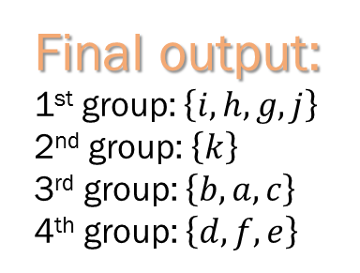
Step-by-Step Example 44/
a
c
e
h
i
b
d
f
g
j
k
Visited | i | h | g | j | k | b | a | c | d | f | e
Finished

